Slide 1

INTELLIGENT REMOTE HEALTHCARE AND ASSISTED LIVING ECOSYSTEM
KNOWLEDGE INSTITUTE OF TECHNOLOGY

Slide 2
INTELLIGENT REMOTE HEALTHCARE AND ASSISTED LIVING ECOSYSTEM
KNOWLEDGE INSTITUTE OF TECHNOLOGY
Smart IoT-Based Patient Monitoring, Fall Detection & Emergency Alert System
Main Technologies:
ESP32
Blynk IoT
MAX30102 Heart Rate & SpO₂ Sensor
MPU6050 Fall Detection Sensor
MLX90614 Temperature Sensor
OLED Display
SOS Push Button
Buzzer

Slide 3
Double Content Slide OBJECTIVES
KNOWLEDGE INSTITUTE OF TECHNOLOGY
An IoT-based system that monitors important patient health parameters and provides remote healthcare assistance for elderly people and patients.
The ESP32 collects heart rate, SpO₂, temperature and motion data from the connected sensors.
The health data is displayed locally through the OLED display and remotely through Blynk IoT.
The system also detects possible falls and provides SOS and emergency buzzer alerts when assistance is required.
To develop a compact, low-cost and intelligent remote healthcare monitoring system
Monitor heart rate.
Measure SpO₂ level.
Monitor body temperature.
Detect possible falls.
Provide an emergency SOS button.
Generate buzzer alerts during emergencies.
Provide remote monitoring using Blynk IoT.
Display health parameters locally using OLED.
Support elderly people and patients in assisted living environments.

Slide 4
Bulleted List Slide
KNOWLEDGE INSTITUTE OF TECHNOLOGY
MAX30102 – Measures heart rate and SpO₂.
MPU6050 – Detects sudden movement and possible falls.
MLX90614 – Measures non-contact temperature.
ESP32 – Main controller and Wi-Fi communication.
OLED Display – Displays health parameters locally.
Buzzer – Provides emergency audio alerts.
SOS Push Button – Allows the user to manually request help.
Blynk IoT – Provides remote monitoring of patient health data.

Slide 5
Comparison Slide
KNOWLEDGE INSTITUTE OF TECHNOLOGY
Compare Section
Contrast Section
Traditional healthcare monitoring mainly depends on manual observation and periodic physical check-ups.
The proposed system uses ESP32 and healthcare sensors to continuously monitor important health parameters and provide remote access to the collected information.
Continuous remote monitoring of patient health parameters using ESP32, sensors, and Blynk IoT.
Automatic fall detection using the MPU6050 sensor for improved patient safety.
Emergency assistance through the SOS button and buzzer alert system.

Slide 6
Prototype
KNOWLEDGE INSTITUTE OF TECHNOLOGY
The prototype consists of an ESP32 connected to heart rate, SpO₂, temperature and motion sensors.
The ESP32 collects sensor readings and displays the information on the OLED display.
The MPU6050 monitors movement and detects possible falls.
The SOS push button allows the user to manually trigger an emergency alert, while the buzzer provides a local warning.
The sensor data is sent through Wi-Fi to the Blynk IoT dashboard for remote monitoring.

Slide 7
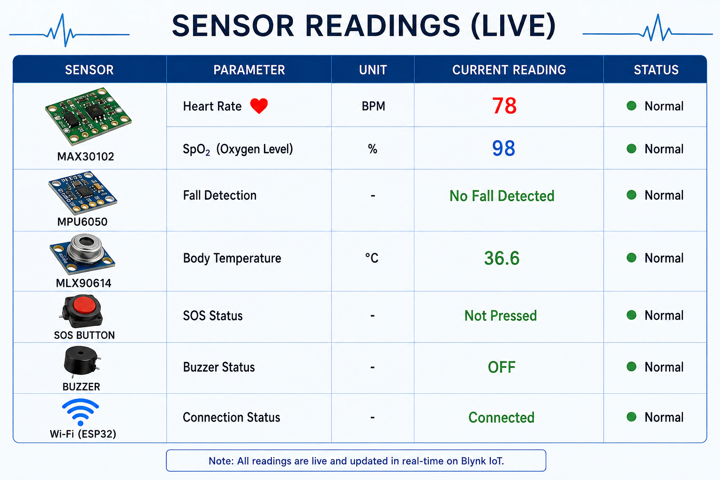
Detection Breakdown
KNOWLEDGE INSTITUTE OF TECHNOLOGY

Slide 8
CONCLUSION
KNOWLEDGE INSTITUTE OF TECHNOLOGY
The Intelligent Remote Healthcare and Assisted Living Ecosystem combines ESP32, healthcare sensors, Blynk IoT, local monitoring and emergency alert systems.
The system provides real-time health monitoring, remote access, fall detection, SOS assistance and emergency alerts.
It provides a practical and low-cost solution for elderly care, remote patient monitoring and assisted living, while reducing the need for continuous physical supervision.

